Slide 1
WPF Input Validation
presented by
Jonathan Birkholz

Slide 2
About Me
Blogs :
theabsentmindedcoder.com
wizardsofsmart.net
Twitter : RookieOne
GitHub : github.com/RookieOne
Email : rookieone@gmail.com

Slide 3
Virtual Brown Bags
What : Virtual Brown Bags
An online meeting where the attendees share:
Tips and tricks
Tools, shortcuts, articles, books, patterns, languages, you name it
Experiences
Things they’ve learned the hard way
Frustrations or difficulties
Frustrating issues or difficulties they’re facing that somebody else may be able to help them with
When : Every Thursday @ 12pm – 1pm
Where : http://snipr.com/virtualaltnet
Who : Anyone and Everyone

Slide 4
EPS Consulting
Custom Software Development
Consulting / Mentoring
Training
WPF
.NET
CODE Magazine
Hiring Developers, PM’s

Slide 5
If you know all this… then feel free to leave
How to do binding validation with:
Validation Rules
Exceptions
IDataErrorInfo
Enterprise Library - Validation Application Block
Markup Extensions

Slide 6
Objective
Not to tell you how to do input validation with WPF
Instead just show you a variety of methods available
In the end, you must decide which methods works best for you

Slide 7
Sample
App to create a list of party invitees
Rules for being an Invitee
Name is required
Age has to be greater than 18
Must have a valid email address

Slide 8
Using Validation Rules

Slide 9
Validation Rules
Validation Rules are the mechanism built into data binding with WPF

Slide 10

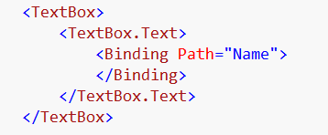
Binding – Markup Extension
Normally you see binding as
but that is just a binding markup extension.
We can also set a binding like this

Slide 11
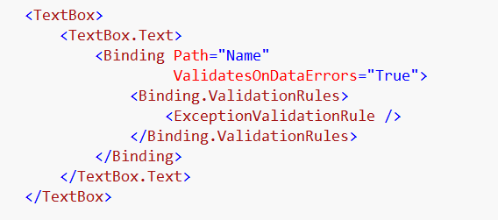
Add Validation Rules to Binding
Binding needs to Validate on Data Error
Allows the setting of Validation Rules to Binding

Slide 12
What Validation Rules come with WPF
DataErrorValidationRule
ExceptionValidationRule

Slide 13
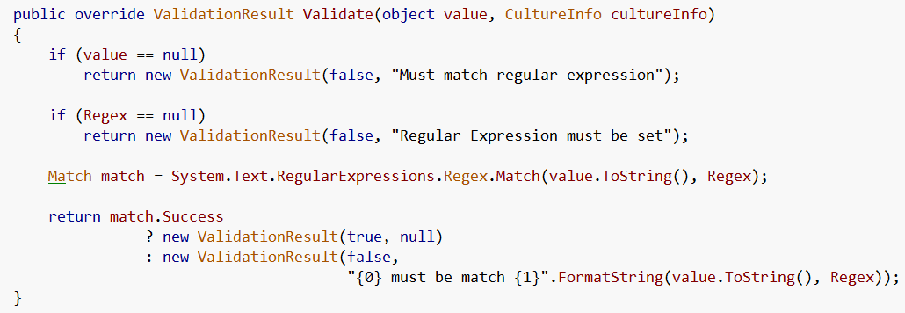
Custom Validation Rules
Just inherit from Validation Rule
And override Validate method …

Slide 14
Implement Validate and return ValidationResult
Fail
Pass
Validation Error Message

Slide 15
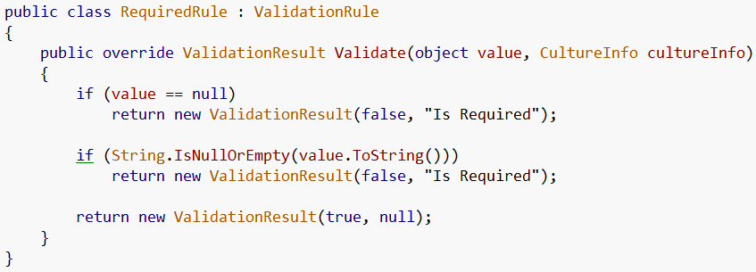
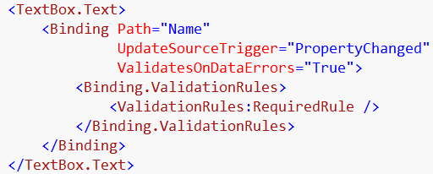
Required

Slide 16
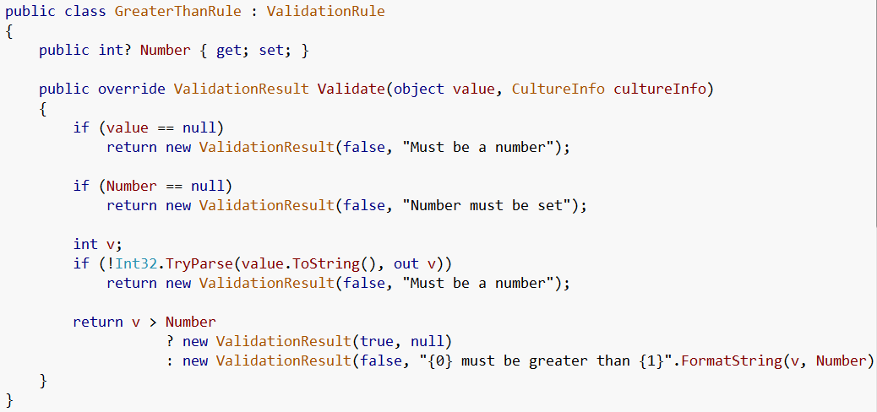
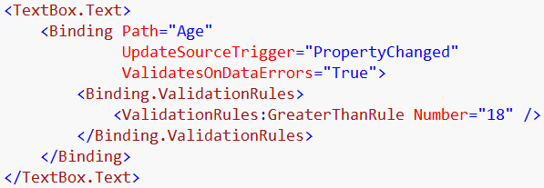
Greater Than

Slide 17
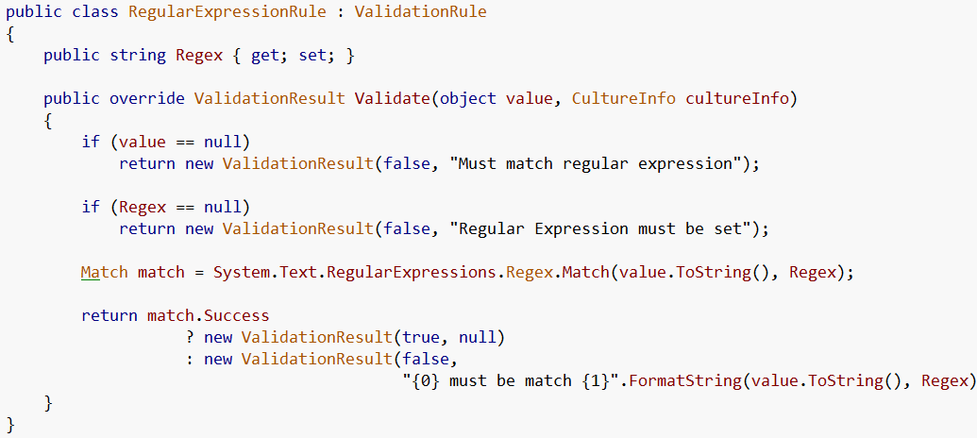
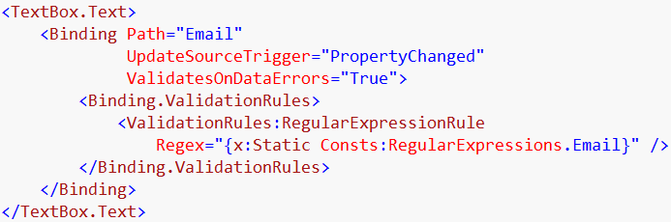
Regular Expression

Slide 18
Displaying the Errors

Slide 19
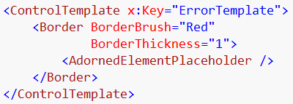
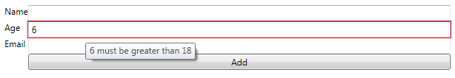
Error Template
Creates the red border

Slide 20
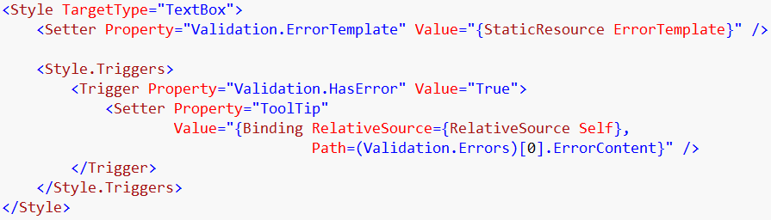
Displaying Error Message
This is setting the error template we specified
This trigger sets the tooltip to the error message

Slide 21
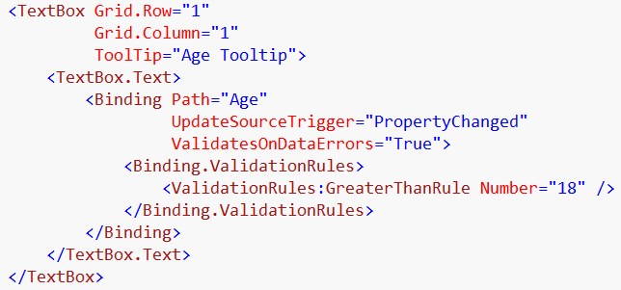

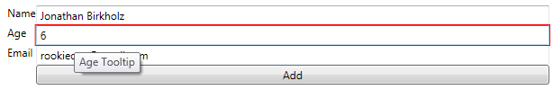
Tooltip Conflicts
Now my normal tooltip shows
Now I loss my Error Message tooltip
This is due to how Property values are resolved … Styles, Triggers, local, etc

Slide 22
Using Exceptions

Slide 23
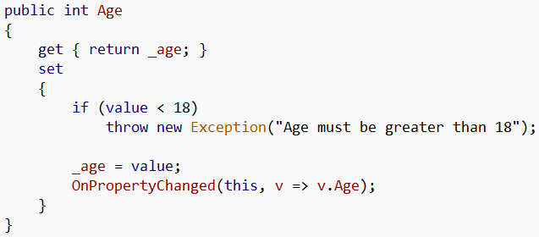
On source…
Throw exception

Slide 24
On binding…
Set ValidatesOnExceptions to True

Slide 25
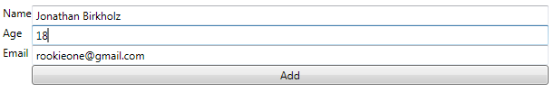


Exception Messages
Hmm… not exactly the error message we would want…
And this message is lame…

Slide 26
Using IDataErrorinfo

Slide 27

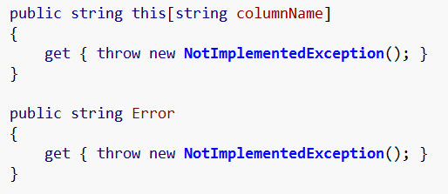
Implement

Slide 28
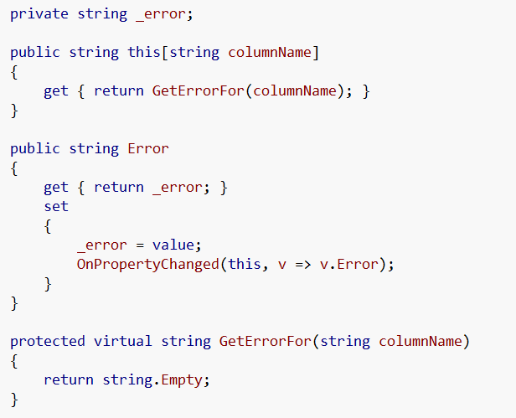
On base ViewModel

Slide 29
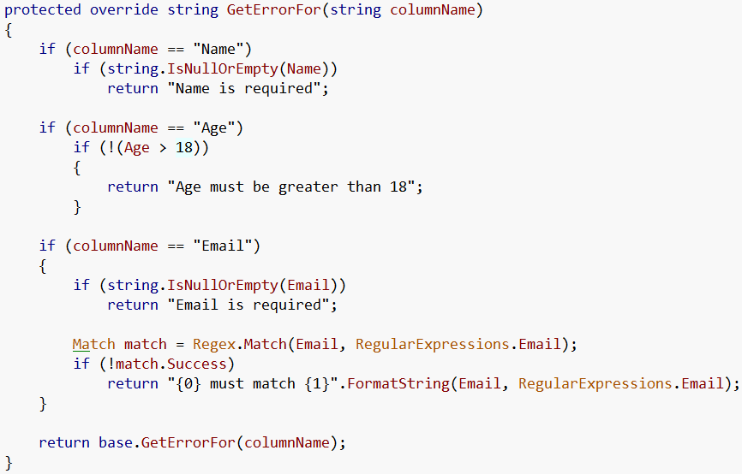
On Party Invitee View Model

Slide 30
On Binding
Validates On Data Errors

Slide 31

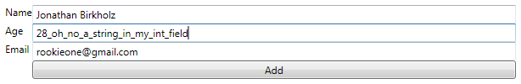
Works great right?
Not quite so perfect….
Bad input… no error

Slide 32
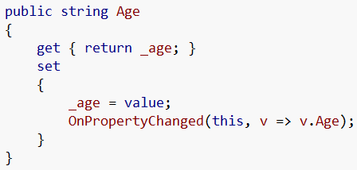
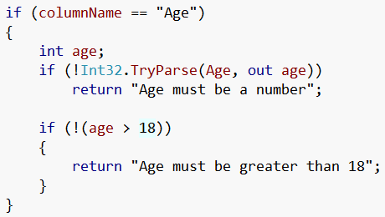
Solution
Make Age a string
Change Error Checking

Slide 33
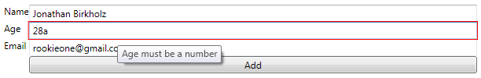
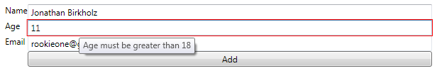

And now…

Slide 34
Enterprise Library

Slide 35
Enterprise Library is
The Microsoft Enterprise Library is a collection of application blocks designed to assist developers with common enterprise development challenges
One of which is the Validation Block

Slide 36
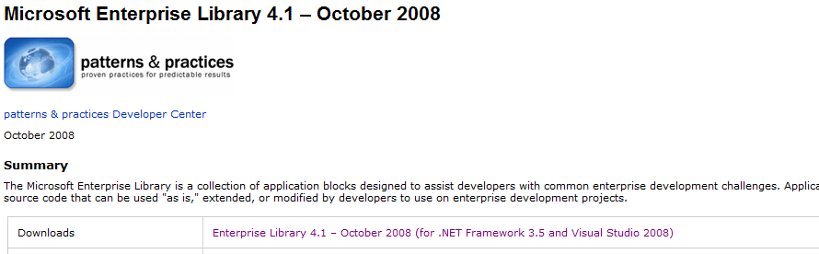
You can get EntLib 4.1 here
http://msdn.microsoft.com/en-us/library/dd203099.aspx

Slide 37
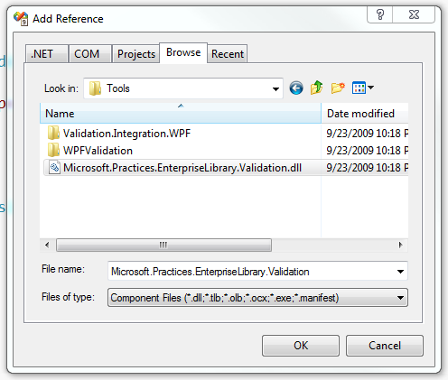
Add Reference

Slide 38
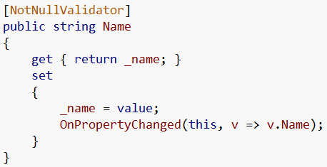
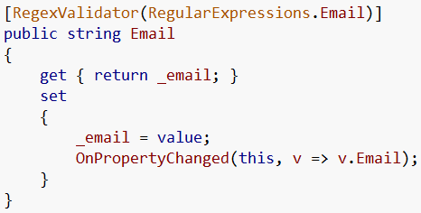
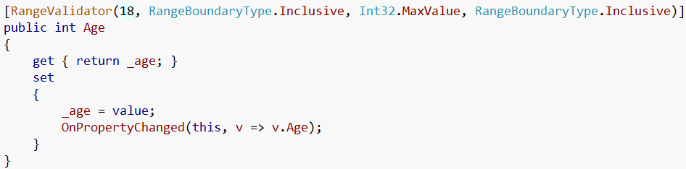
Use Validation Attributes

Slide 39
Error Provider
Martin Bennedik @
http://www.bennedik.de/2007/04/wpf-integration-for-validation.html
Download WPF Validation project
Has the ErrorProvider control
The error provider recursively finds all the bindings down the Logical Tree and adds the Enterprise Validation Rule to the bindings

Slide 40
On View
Wrap bindings to validate with the Error Provider
Bindings can remain simple

Slide 41



In action
Not exactly the best out of the box messages…

Slide 42
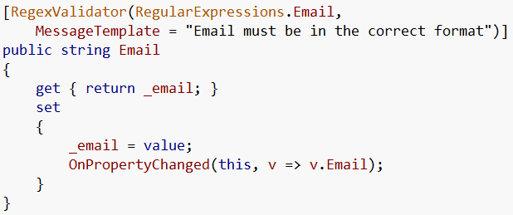
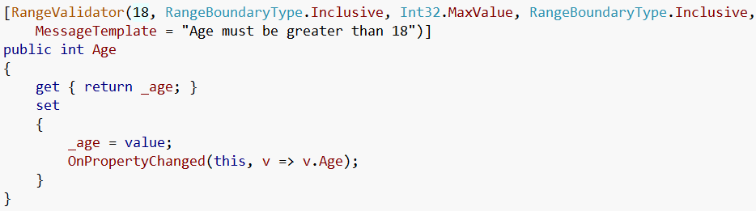
Setting the Error Message

Slide 43

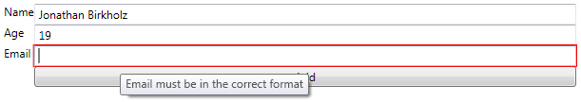
New and improved

Slide 44
Custom markup extension

Slide 45
Markup Extensions
The most common markup extensions used in WPF programming are those that support resource references (StaticResource and DynamicResource), and those that support data binding (Binding)
Static Resource
Dynamic Resource
Binding

Slide 46
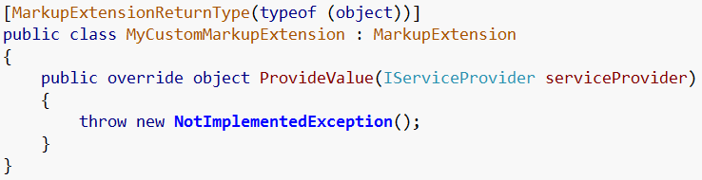
Custom Markup Extensions
We can make our own markup extensions
Use attribute to specify markup extension return type
Inherit from MarkupExtension
Implement ProvideValue

Slide 47
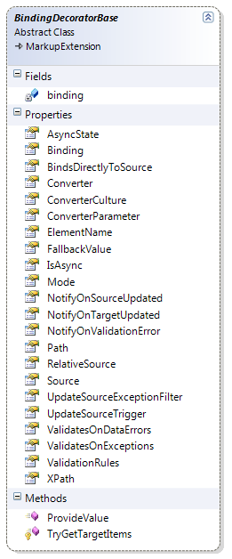
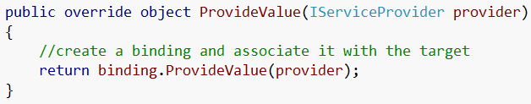
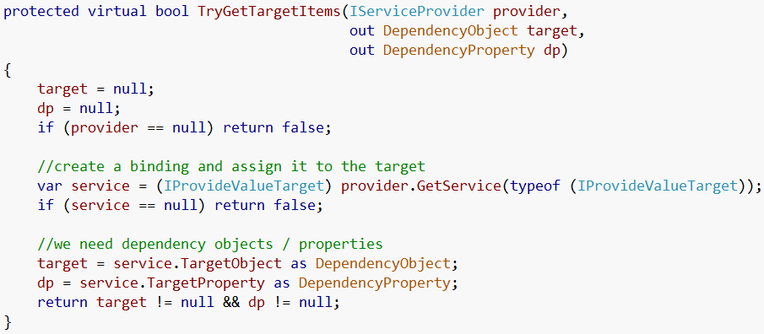
Binding Decorator Base
Philip Sumi @
http://www.hardcodet.net/2008/04/wpf-custom-binding-class

Slide 48
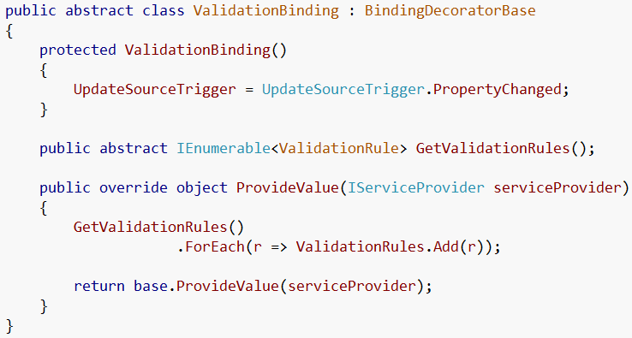
Base Validation Binding

Slide 49
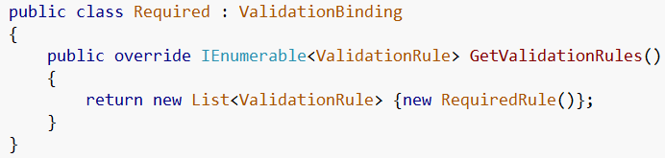
Required
Implementation
Xaml

Slide 50
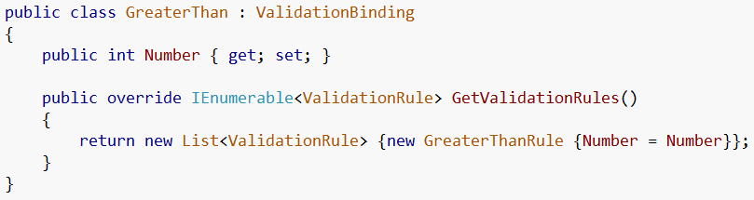
Greater Than
Implementation
Xaml

Slide 51
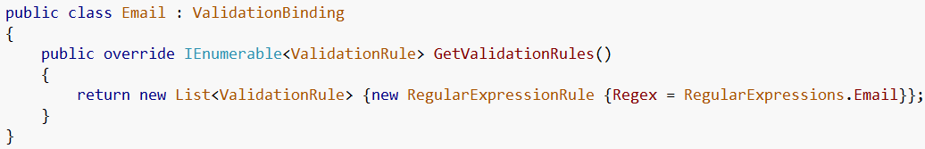
Email
Implementation
Xaml

Slide 52
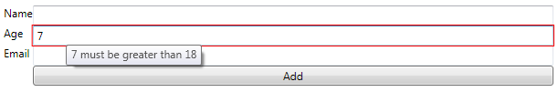
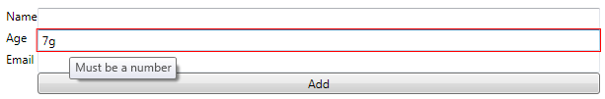

With Custom Markup Extensions

Slide 53
Conclusion
We covered how we can do WPF Input Validation with
Validation Rules
Exceptions
IDataErrorInfo
Enterprise Library Validation Block
Custom Markup Extensions

Slide 54
Questions
?

Slide 55
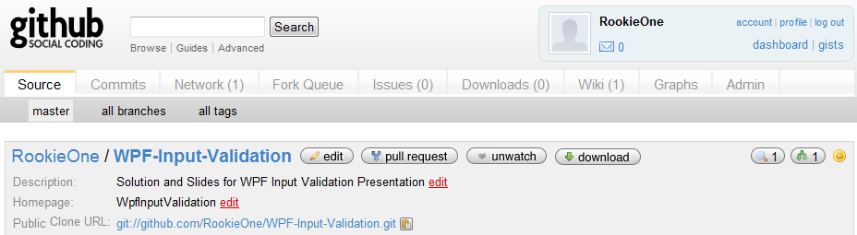
Git Hub Repository
http://github.com/RookieOne/WPF-Input-Validation
Has solution with projects and slide show
Offered as is

Slide 56
References
MSDN
http://msdn.microsoft.com/en-us/library/dd203099.aspx
Blogs and articles by
Josh Smith
Karl Shifflet
Martin Bennedik
Philip Sumi

